Slide 1
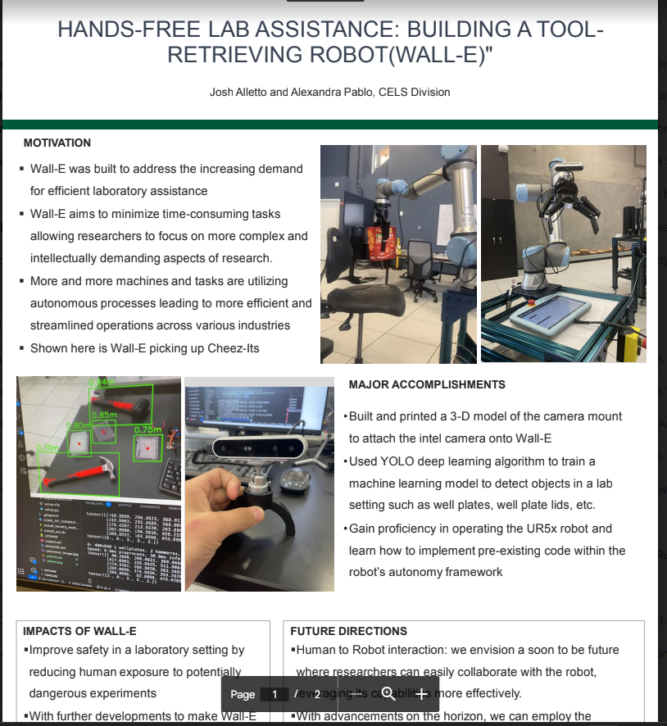

Updates:
Joshua Alletto
-Utilizing a previous function to gather 3d distance information of object
-Calculation created to get robot over to top of object
-Finished presentation for Learning on the lawn
-Offered Internship position at Nextera(Power distribution)
Future Goals:
-Finish collaboration of camera code and robot code, run it with no errors
-Set up and execute a mission for robot

